Slide 1

Machine Learning
ESCUELA FULLSTACK

Slide 2
¡Bievenidos al Curso! Docente: Fiorella Henriquez

Slide 3

Machine Learning
ESCUELA FULLSTACK

Slide 4
CONTENIDO DEL CURSO
SECCIÓN 1: INTRODUCCIÓN
Qué es Machine Learning y casos de uso
Presentación del caso aplicativo
SECCIÓN 2
CONCEPTOS BÁSICOS
Modelos de aprendizaje supervisado
Modelos de aprendizaje no supervisado
Diferencias entre aprendizaje supervisado y no supervisado
Metodología CRISP-DM
Machine Learning vs. Analytics
Machine Learning en Python

Slide 5
CONTENIDO DEL CURSO
SECCIÓN 3
TRANSFORMACIÓN DE DATOS PARA EL MODELO
Formato tidy data
Limpieza de valores nulos o faltantes
Selección de variables target y predictores
Reducción de dimensiones
Entrenamiento y prueba de modelos
Caso aplicativo: preparación de los datos
SECCIÓN 4
MODELOS DE MACHINE LEARNING
Elección del modelo
Análisis exploratorio y visualización de datos
Regresión lineal y logística
Árboles de decisión
Clustering/agrupamiento
SECCIÓN 5
CIERRE DEL CASO APLICATIVO

Slide 6
Machine Learning
ESCUELA FULLSTACK

Slide 7
¿Qué es Machine Learning?
INTELIGENCIA ARTIFICIAL
MACHINE LEARNING
DEEP LEARNING
Notes:
AI, machine learning, and deep learning - these terms overlap and are easily confused, so let’s start with some short definitions.
AI means getting a computer to mimic human behavior in some way.
Machine learning is a subset of AI, and it consists of the techniques that enable computers to figure things out from the data and deliver AI applications. The solution turned out to be not just mimicking human behavior (AI) but mimicking how humans learn.
Deep learning, meanwhile, is a subset of machine learning that enables computers to solve more complex problems.
What Is AI?
Artificial intelligence as an academic discipline was founded in 1956. The goal then, as now, was to get computers to perform tasks regarded as uniquely human: things that required intelligence. Initially, researchers worked on problems like playing checkers and solving logic problems.
If you looked at the output of one of those checkers playing programs you could see some form of “artificial intelligence” behind those moves, particularly when the computer beat you. Early successes caused the first researchers to exhibit almost boundless enthusiasm for the possibilities of AI, matched only by the extent to which they misjudged just how hard some problems were.
Artificial intelligence, then, refers to the output of a computer. The computer is doing something intelligent, so it’s exhibiting intelligence that is artificial.
The term AI doesn’t say anything about how those problems are solved. There are many different techniques including rule-based or expert systems. And one category of techniques started becoming more widely used in the 1980s: machine learning.
What Is Machine Learning?
The reason that those early researchers found some problems to be much harder is that those problems simply weren't amenable to the early techniques used for AI. Hard-coded algorithms or fixed, rule-based systems just didn’t work very well for things like image recognition or extracting meaning from text.
The solution turned out to be not just mimicking human behavior (AI) but mimicking how humans learn.
Think about how you learned to read. You didn’t sit down and learn spelling and grammar before picking up your first book. You read simple books, graduating to more complex ones over time. You actually learned the rules (and exceptions) of spelling and grammar from your reading. Put another way, you processed a lot of data and learned from it.
That’s exactly the idea with machine learning. Feed an algorithm (as opposed to your brain) a lot of data and let it figure things out. Feed an algorithm a lot of data on financial transactions, tell it which ones are fraudulent, and let it work out what indicates fraud so it can predict fraud in the future. Or feed it information about your customer base and let it figure out how best to segment them.
As these algorithms developed, they could tackle many problems. But some things that humans found easy (like speech or handwriting recognition) were still hard for machines. However, if machine learning is about mimicking how humans learn, why not go all the way and try to mimic the human brain? That’s the idea behind neural networks.
The idea of using artificial neurons (neurons, connected by synapses, are the major elements in your brain) had been around for a while. And neural networks simulated in software started being used for certain problems. They showed a lot of promise and could solve some complex problems that other algorithms couldn’t tackle.
But machine learning still got stuck on many things that elementary school children tackled with ease: how many dogs are in this picture or are they really wolves? Walk over there and bring me the ripe banana. What made this character in the book cry so much?
It turned out that the problem was not with the concept of machine learning. Or even with the idea of mimicking the human brain. It was just that simple neural networks with 100s or even 1000s of neurons, connected in a relatively simple manner, just couldn’t duplicate what the human brain could do. It shouldn't be a surprise if you think about it; human brains have around 86 billion neurons and very complex interconnectivity.
What is Deep Learning?
Put simply, deep learning is all about using neural networks with more neurons, layers, and interconnectivity. We’re still a long way off from mimicking the human brain in all its complexity, but we’re moving in that direction.
And when you read about advances in computing from autonomous cars to Go-playing supercomputers to speech recognition, that’s deep learning under the covers. You experience some form of artificial intelligence. Behind the scenes, that AI is powered by some form of deep learning.
Let’s look at a couple of problems to see how deep learning is different from simpler neural networks or other forms of machine learning.
How Deep Learning Works
If I give you images of horses, you recognize them as horses, even if you’ve never seen that image before. And it doesn’t matter if the horse is lying on a sofa, or dressed up for Halloween as a hippo. You can recognize a horse because you know about the various elements that define a horse: shape of its muzzle, number and placement of legs, and so on.
Deep learning can do this. And it’s important for many things including autonomous vehicles. Before a car can determine its next action, it needs to know what’s around it. It must be able to recognize people, bikes, other vehicles, road signs, and more. And do so in challenging visual circumstances. Standard machine learning techniques can’t do that.

Slide 8

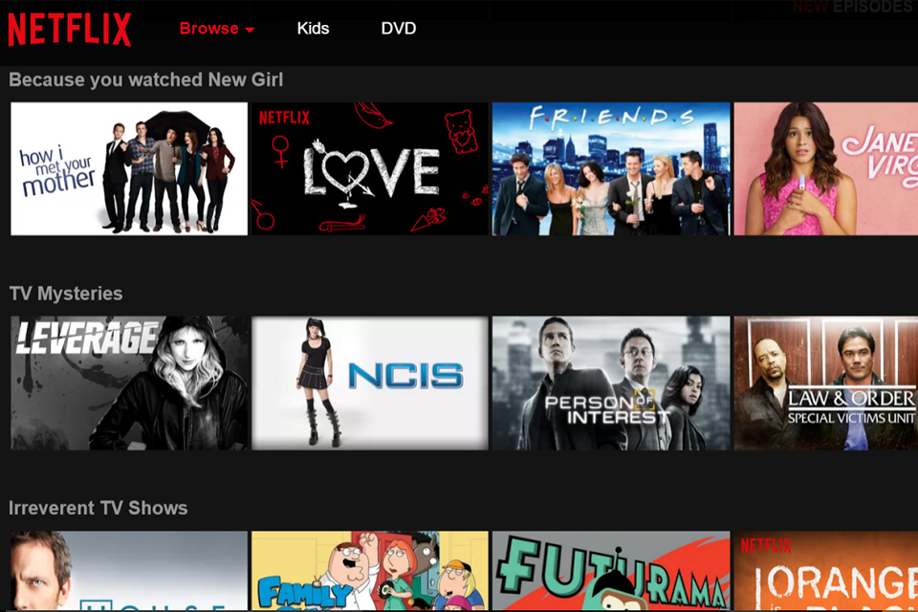



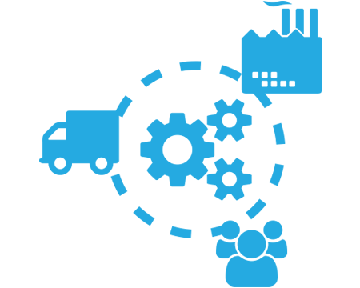
USOS DE MACHINE LEARNING
Automatización de procesos
Predicción de demanda
Sistemas de recomendación
Detección de spam
Diagnóstico de pacientes
Optimización de inventario

Slide 9

CASO APLICATIVO

Slide 10


Slide 11
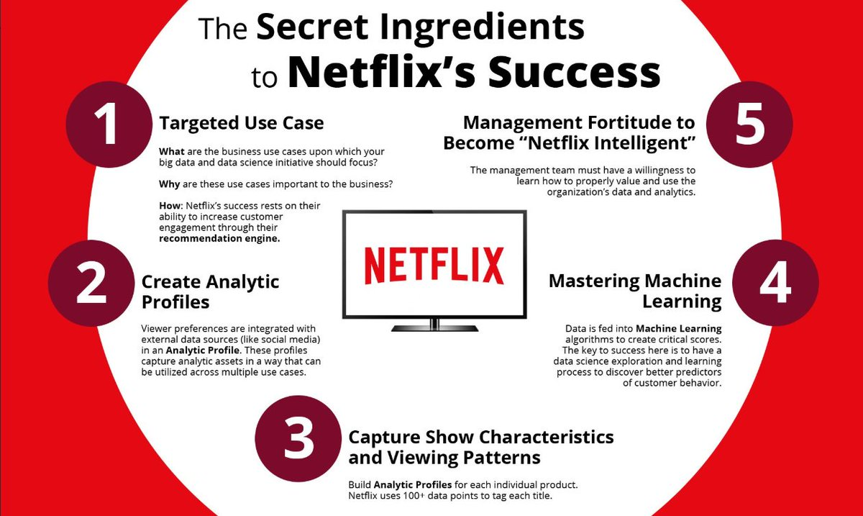

Slide 12


Slide 13
Machine Learning
ESCUELA FULLSTACK

Slide 14
TIPOS DE VARIABLES
Numéricas
Categóricas
Precio de una casa
Peso
Ventas de un producto
Likes en Instagram
Número de hijos
Edad
Ciudad de residencia
Color favorito
Estado civil
Tiene cuenta de Instagram
Tipo de sangre
Rangos de edad
Notes:
La data numérica también puede ser continua o discreta. Por ejemplo el número de hijos o la edad en años es discreto porque son números enteros, mientras que el ingreso mensual es una variable continua.
Mencionar rangos de peso. La Categórica puede ser Sí/No, o muchas opciones.

Slide 15

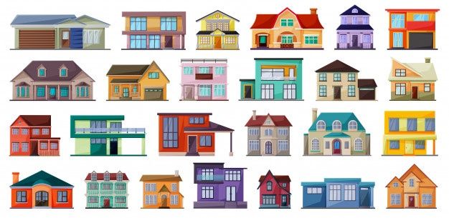
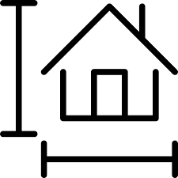



VARIABLES PARA UN MODELO
Variable target/objetivo
Predictores
Precio de una casa
m2
#Habitaciones
Distrito
#Baños
Estacionamiento

Slide 16


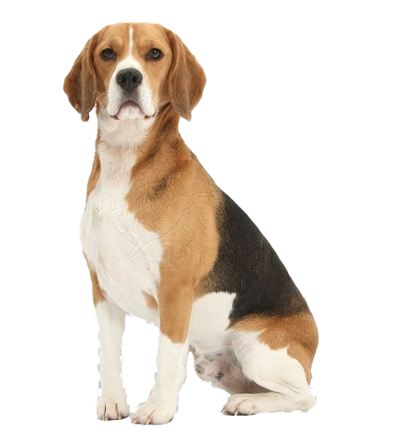
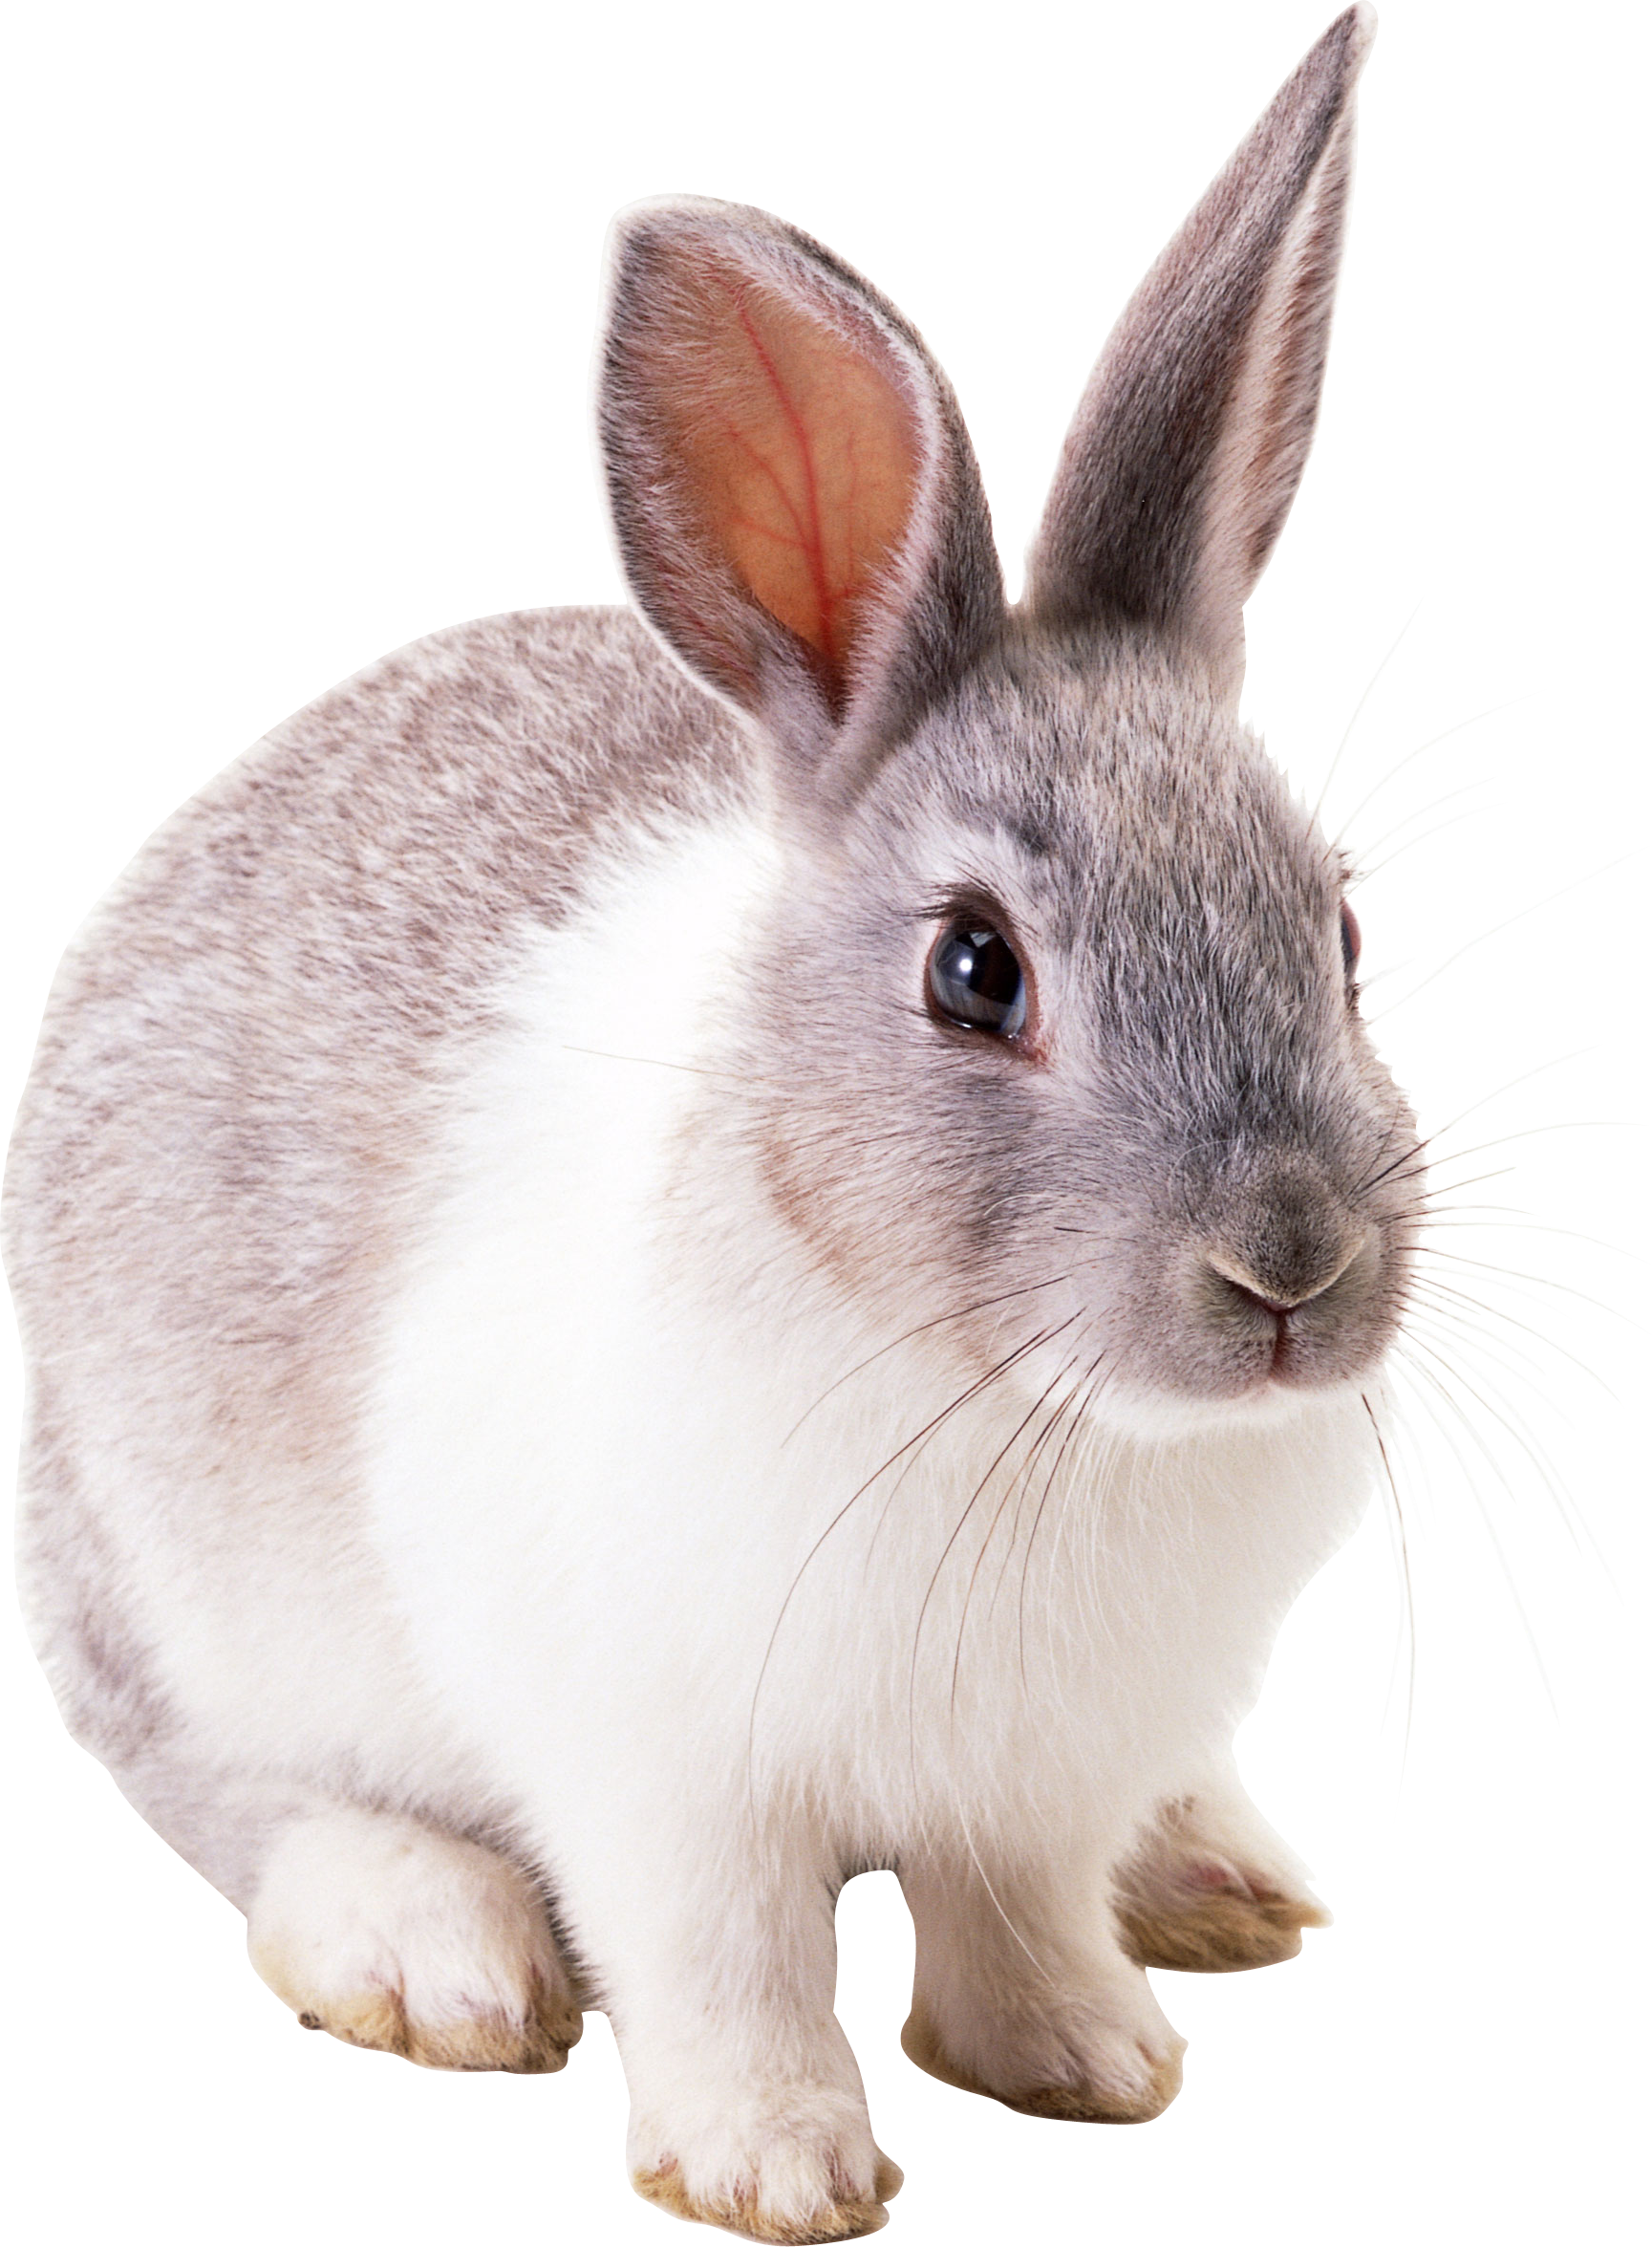


APRENDIZAJE SUPERVISADO
Perro
APRENDIZAJE SUPERVISADO
MODELO PREDICTIVO
No Perro
MODELO PREDICTIVO
Perro
Notes:
Supervised learning is the machine learning task of learning a function that maps an input to an output based on example input-output pairs. It infers a function from labeled training data consisting of a set of training examples.

Slide 17

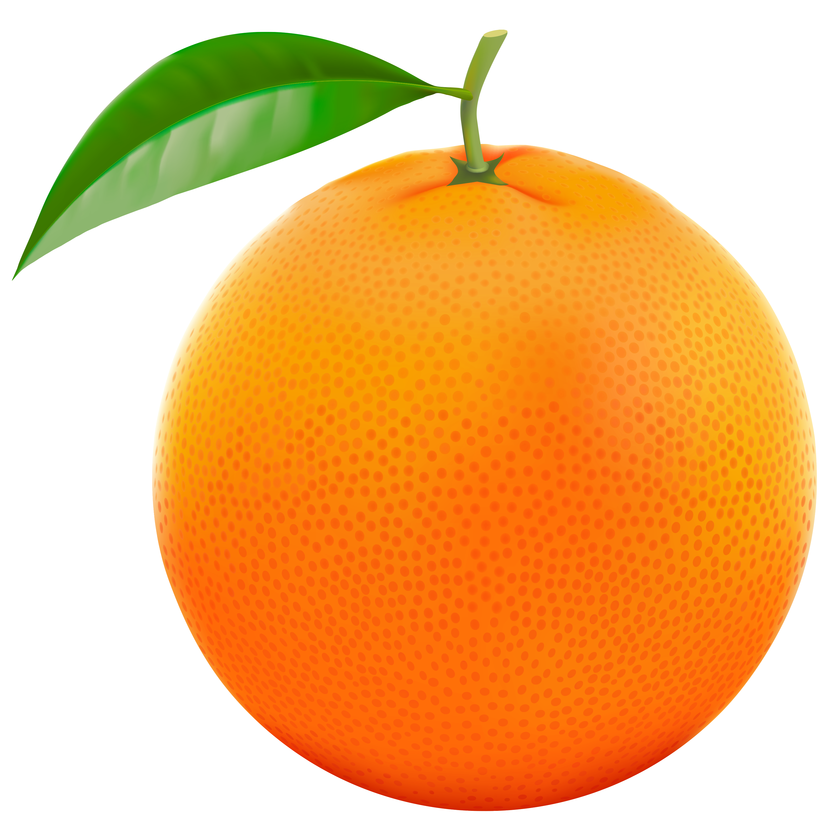
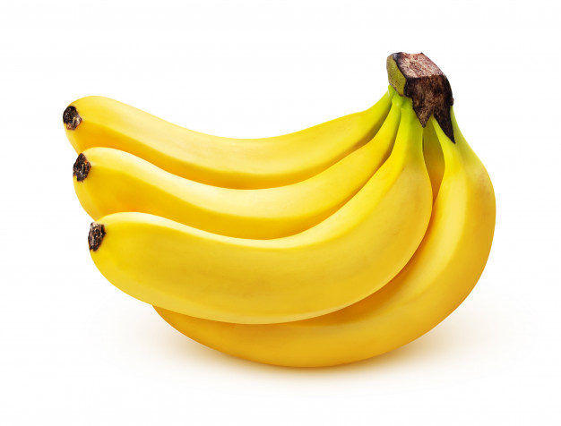
APRENDIZAJE NO SUPERVISADO
MODELO PREDICTIVO
APRENDIZAJE NO SUPERVISADO
Notes:
Unsupervised learning is a type of machine learning algorithm used to draw inferences from datasets consisting of input data without labeled responses. The most common unsupervised learning method is cluster analysis, which is used for exploratory data analysis to find hidden patterns or grouping in data.

Slide 18
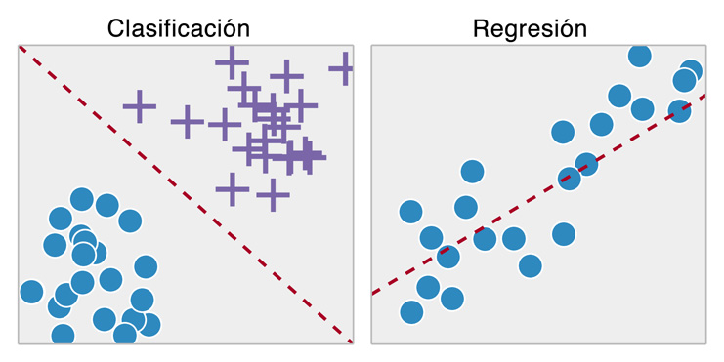
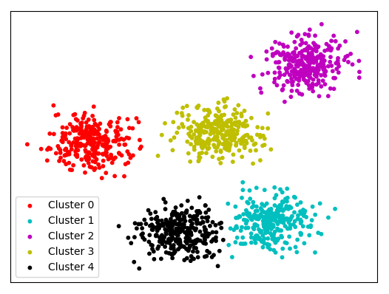
SUPERVISADO VS. NO SUPERVISADO
APRENDIZAJE SUPERVISADO
APRENDIZAJE NO SUPERVISADO
Se conoce la variable target
No se conoce la variable target
Target Categórica
Target Numérica

Slide 19
APRENDIZAJE SUPERVISADO
Regresión
Clasificación
Regresión lineal
Árboles de regresión
Regresión no lineal
Support vector Regression
Ridge/Lasso/Elastic Net
Redes neuronales
Regresión logística
Árboles de decisión
K-Nearest Neighbors
Naive Bayes
Support vector machines
Random Forest

Slide 20
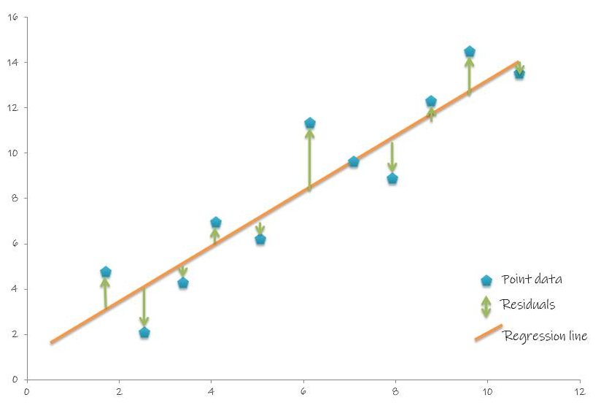
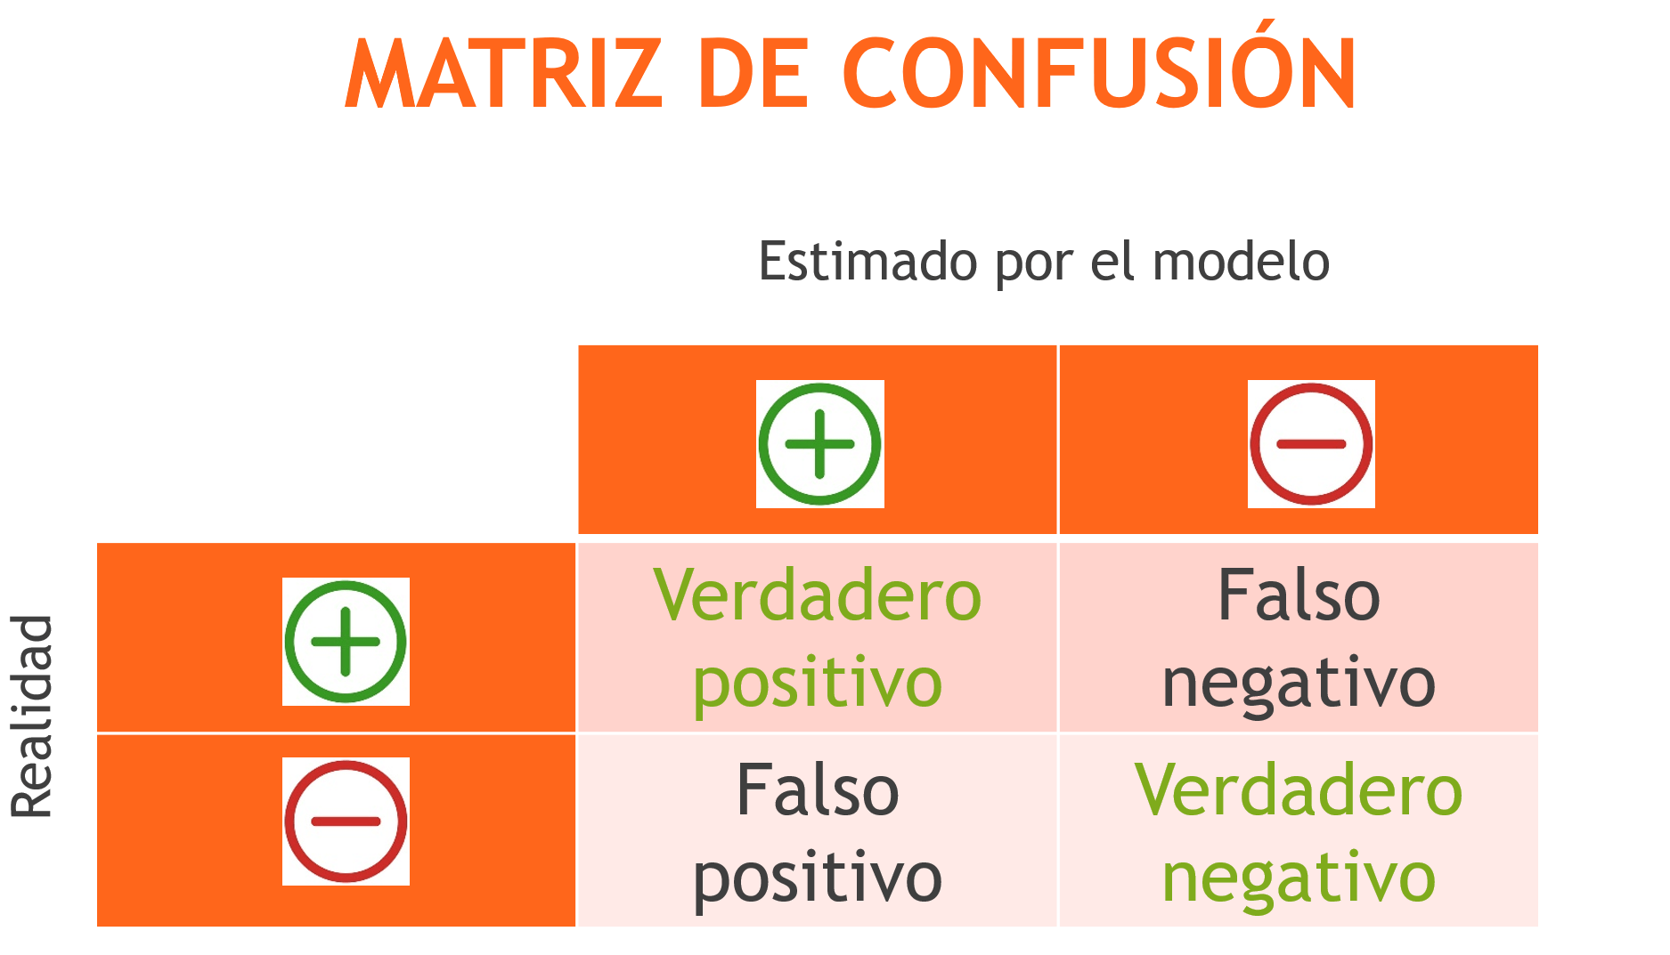
VALIDACIÓN DEL MODELO
Regresión
Clasificación
Error medio absoluto
Error cuadrático medio

Slide 21
APRENDIZAJE NO SUPERVISADO
Clustering
K-means
K-modes
Principal Component Analysis
Redes neuronales
CLARA
PAM

Slide 22
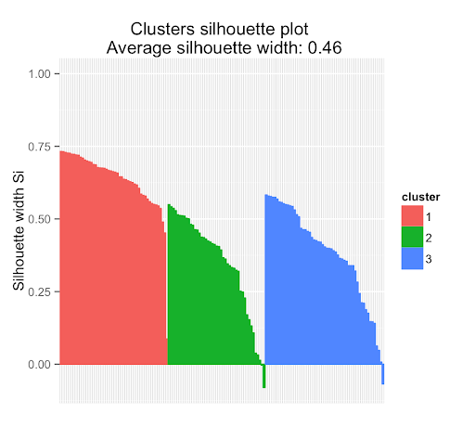
VALIDACIÓN DEL MODELO
Coeficiente de silueta
Método gráfico

Slide 23
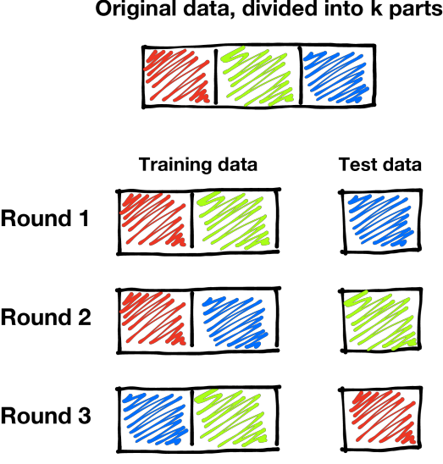
VALIDACIÓN CRUZADA

Slide 24
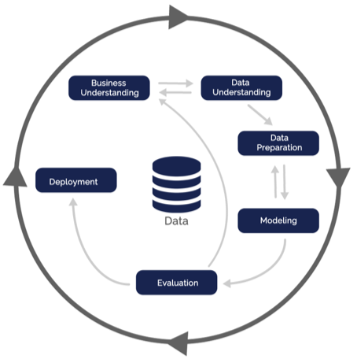
METODOLOGÍA CRISP-DM
Cross Industry Standard Process for Data Mining
Proceso:
Entendimiento de negocio
Entendimiento de la data
Preparación de la data
Modelamiento
Evaluación
Despliegue

Slide 25

MACHINE LEARNING vs. ANALYTICS
ANALYTICS
MACHINE LEARNING
Análisis exploratorio y estadístico
Manipulación de datos
Visualización de datos
Generación de insights
Activación de negocio
Aplicación de algoritmos
Estadística inferencial
Acceso masivo a datos
Automatización de modelos para activación
Generación de insights
Notes:
Analytics Person in data analytics is the one who perform basic statistics calculation, database manipulation & transformation, visualize data and conclude the data points by providing meaningful insights from provided dataset. Business takes significant decisions based on these insights.
SKILLS REQUIRED
Database management using SQL, statistical analysis using R/Python, Excel, reporting via using any BI tools.
What is Machine Learning?
If we say data analytics is at level 1 then machine learning is at level 2. This comprises of study and application of algorithms to extract data and provide statistical inferences. Here algorithms improve themselves from data experience without rely on specific programming. When data changes, the algorithm are designed in such a way appropriate action is enabled whenever any change in pattern is observed.
SKILLS REQUIRED
Expertise in programming skills like R/Python, sharp statistical and probability understanding, good at data modelling techniques along with other skills required for data analytics.

Slide 26
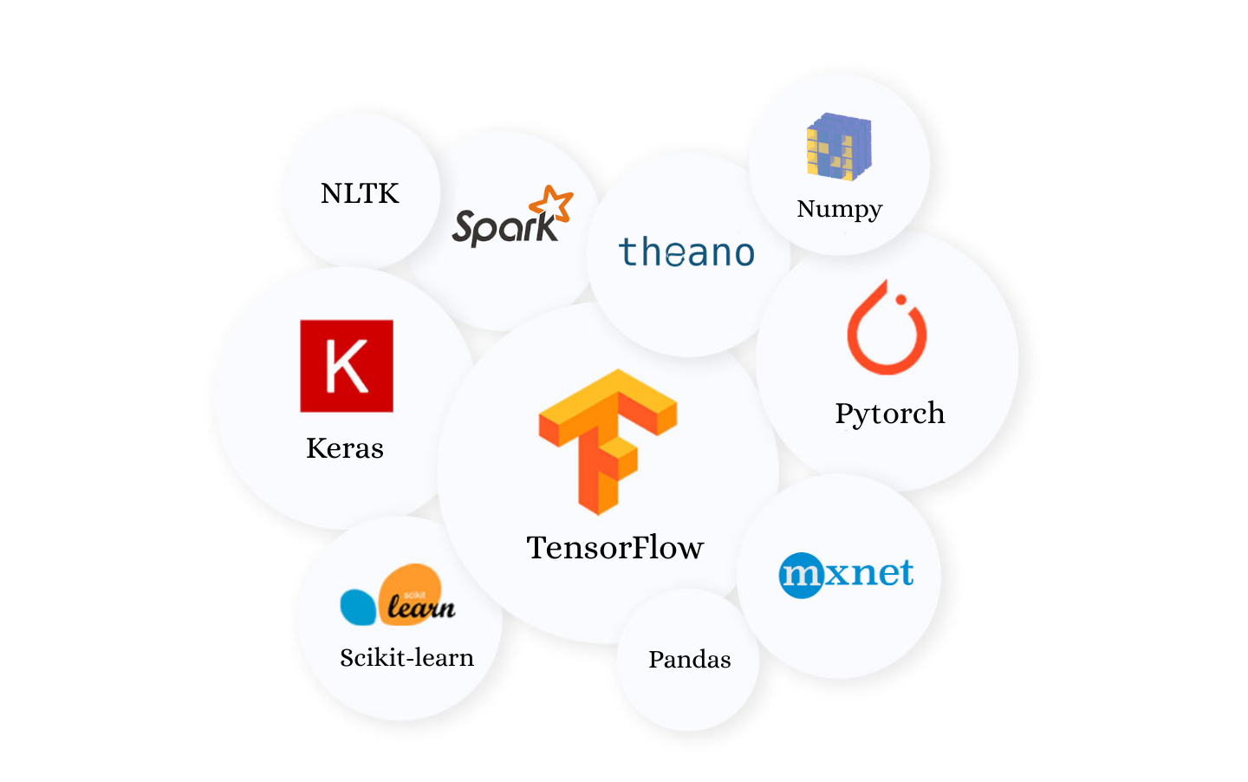
MACHINE LEARNING EN PYTHON
Notes:
Pandas is a Python data analysis library and is used primarily for data manipulation and analysis.
The NumPy library for Python concentrates on handling extensive multi-dimensional data and the intricate mathematical functions operating on the data. NumPy offers speedy computation and execution of complicated functions working on arrays.
Scikit-learn is another actively used machine learning library for Python. It includes easy integration with different ML programming libraries like NumPy and Pandas. Scikit-learn comes with the support of various algorithms such as:
● Classification
● Regression
● Clustering
● Dimensionality Reduction
● Model Selection
● Preprocessing
TensorFlow is one of the best library available for working with Machine Learning on Python. Offered by Google, TensorFlow makes ML model building easy for beginners and professionals alike.
Using TensorFlow, you can create and train ML models on not just computers but also mobile devices and servers by using TensorFlow Lite and TensorFlow Serving that offers the same benefits but for mobile platforms and high-performance servers.
Keras is one of the most popular and open-source neural network libraries for Python. Initially designed by a Google engineer for ONEIROS, short for Open-Ended Neuro Electronic Intelligent Robot Operating System, Keras was soon supported in TensorFlow’s core library making it accessible on top of TensorFlow. Keras features several of the building blocks and tools necessary for creating a neural network.
Developed by Facebook, PyTorch is one of the few machine learning libraries for Python. Apart from Python, PyTorch also has support for C++ with its C++ interface if you’re into that. Considered among the top contenders in the race of being the best Machine Learning and Deep Learning framework, PyTorch faces touch competition from TensorFlow.
NLTK stands for Natural Language Toolkit and is a Python library for working with natural language processing. It is considered as one of the most popular libraries to work with human language data.
Spark: Developed by Apache, Spark MLlib is a machine learning library that enables easy scaling of your computations. It is simple to use, quick, easy to set up and offers smooth integration with other tools. Spark MLlib instantly became a convenient tool for developing machine learning algorithms and applications.
Theano is a powerful Python library enabling easy defining, optimizing and evaluation of powerful mathematical expressions.
If your field of expertise includes Deep Learning, you will find MXNet to be the perfect fit. Used to train and deploy deep neural networks, MXNet is highly scalable and supports quick model training.

Slide 27
Machine Learning
ESCUELA FULLSTACK

Slide 28

TIDY DATA

Slide 29
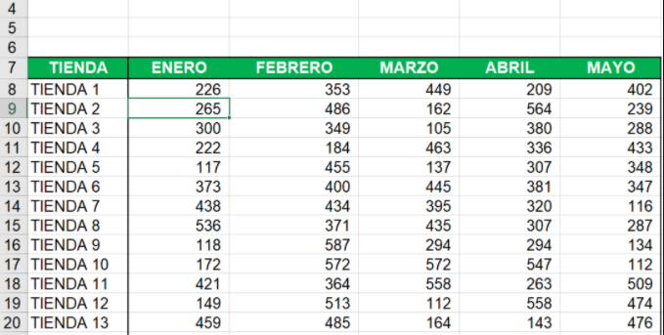
TIDY DATA
TIENDA | MES | VENTAS
TIENDA 1 | ENERO | 226
TIENDA 2 | ENERO | 265
TIENDA 3 | ENERO | 300

Slide 30
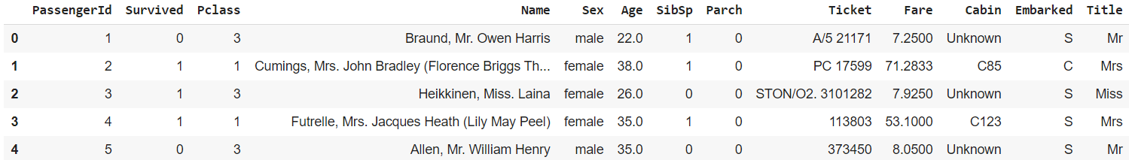
VARIABLE TARGET Y PREDICTORES
Entendimiento del problema: Definir de qué depende que un pasajero haya sobrevivido
Entendimiento de los datos: qué variables tenemos disponibles
Definición de la variable target y predictores
Variable target
Predictores
Clase
Género
#espos@/
hermanos
Costo ticket
Dónde embarcó
Edad
#padres/
hijos
Cabina
Título

Slide 31
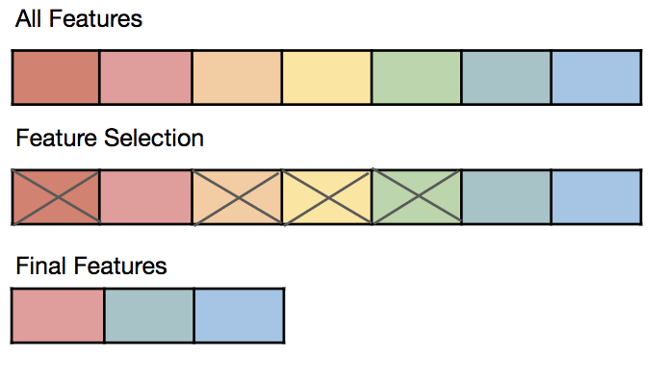
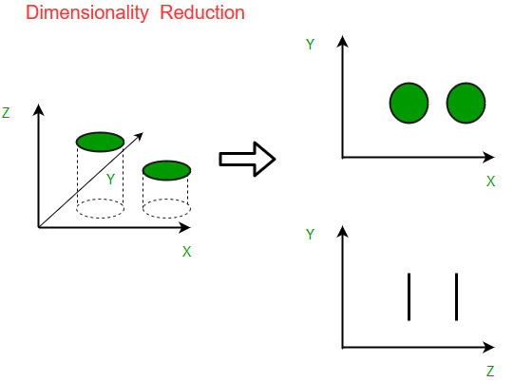
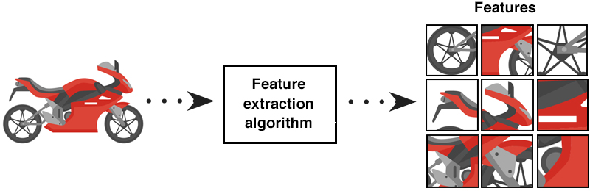
DEFINIENDO LOS PREDICTORES
Feature Selection
Selección de Atributos
Dimensionality Reduction
Reducción de dimensiones
Feature Extraction
Extracción de Atributos

Slide 32
MÉTODOS PARA FEATURE SELECTION
Correlación entre variables: ¿hay algunas que sean “redundantes”?
Recursive Feature Elimination RFE: eliminar de forma recursiva las menos relevantes
Técnicas estadísticas
Input del negocio o de expertos
Árboles de decisión: ranking de atributos

Slide 33
VARIABLES CATEGÓRICAS
Sex | Is Male | Sex num
Male | 1 | 1
Female | 0 | 2
Female | 0 | 2
Male | 1 | 1

Slide 34
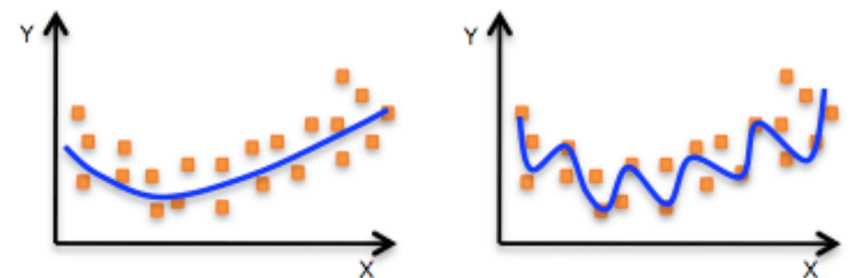
OVERFITTING
Modelo fit
Modelo over-fit

Slide 35
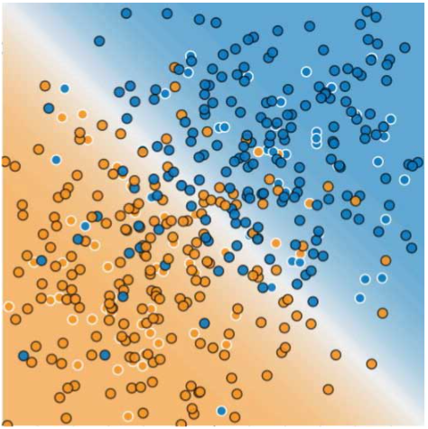
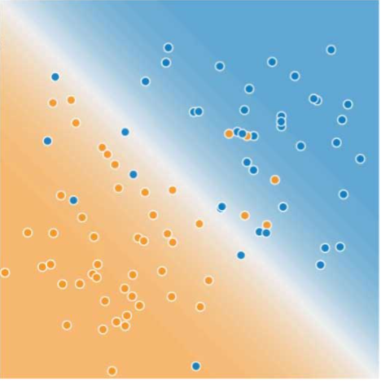
SETS DE TRAINING Y TEST
Training data
Test data

Slide 36
VALIDACIÓN CRUZADA (K-FOLD)

Slide 37
Machine Learning
ESCUELA FULLSTACK

Slide 38
ELECCIÓN DEL MODELO
DEFINIR LA PREGUNTA O EL PROBLEMA
DEFINIR EL TIPO DE MODELO
DEFINIR EL O LOS MODELOS QUE PUEDEN APLICAR
Para elegir el o los modelos de Machine Learning correcto debemos empezar por la metodología CRISP-DM, teniendo un buen entendimiento de la pregunta a responder y los datos, habiéndolos transformado y teniendo las variables a usar necesarias.

Slide 39
ELECCIÓN DEL MODELO
DEFINIR LA PREGUNTA O EL PROBLEMA
DEFINIR EL TIPO DE MODELO
DEFINIR EL O LOS MODELOS QUE PUEDEN APLICAR
Luego debemos definir si es un modelo de aprendizaje supervisado o no supervisado: ¿tenemos una variable target definida?)
Entonces definimos si es un modelo de Clasificación (variable target categórica), de Regresión (variable target numérica) o de Clustering (sin variable target)

Slide 40
ELECCIÓN DEL MODELO
DEFINIR LA PREGUNTA O EL PROBLEMA
DEFINIR EL TIPO DE MODELO
DEFINIR EL O LOS MODELOS QUE PUEDEN APLICAR
Ya que conocemos que hay varios modelos de cada tipo, debemos explorar cuál es el modelo correcto para nuestro caso en base a bibliografía o información adicional sobre los modelos u otras aplicaciones que se hayan realizado antes.
En muchos casos, se elegirá un set de modelos a evaluar y luego validaremos cuál tiene el mejor resultado por lo cual se elegirá como el ganador.

Slide 41
ANÁLISIS EXPLORATORIO DE DATOS
Evaluar datos, cantidad y tipos de dato
Dataframe, columns, value_counts, dtypes, shape
Revisar valores nulos o faltantes
isna, fillna, dropna
Medidas estadísticas y de tendencia: varianza, desviación estándar, rango, media, mediana, moda
Python: describe, stdev, variance, range, mean, mode, median
Visualización de datos: histograma, boxplot, gráficas de barras, gráficas de dispersión, etc.
Evaluar relaciones entre las variables

Slide 42

ANÁLISIS EXPLORATORIO DE DATOS
Evaluar datos, cantidad y tipos de dato
Dataframe, columns, value_counts, dtypes, shape
Revisar valores nulos o faltantes
isna, fillna, dropna
Medidas estadísticas y de tendencia: varianza, desviación estándar, rango, media, mediana, moda
Python: describe, stdev, variance, range, mean, mode, median
Visualización de datos: histograma, boxplot, gráficas de barras, gráficas de dispersión, etc.
Evaluar relaciones entre las variables

Slide 43
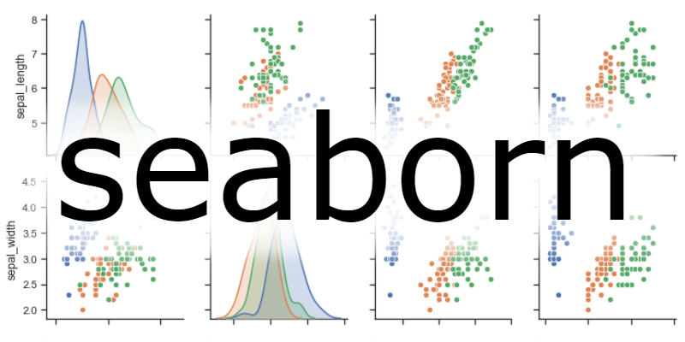


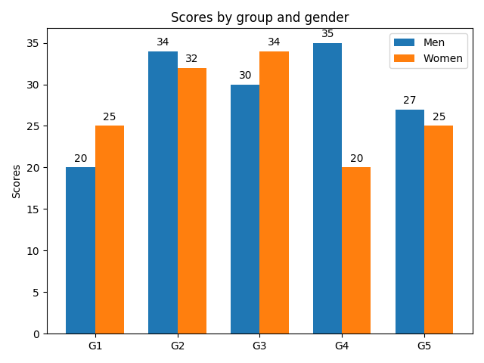
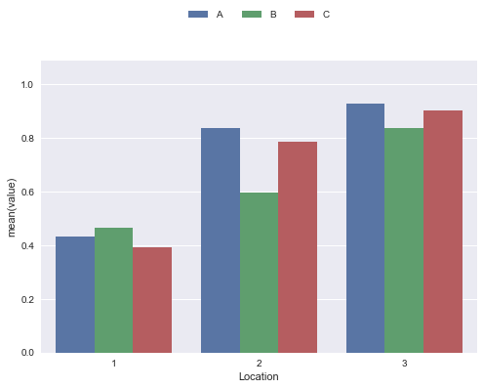
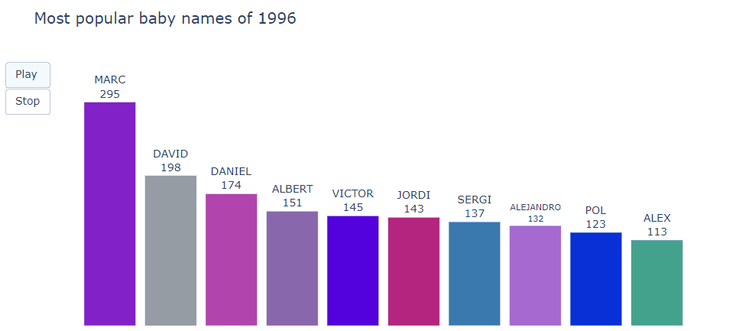
VISUALIZACIÓN DE DATOS
Matplotlib
Es la librería más usada. Muy flexible y configurable.
Seaborn
Funciona sobre Matplotlib. Incluye un diseño pre definido
Plotly
Fácil de usar, con buen diseño e interactividad.

Slide 44
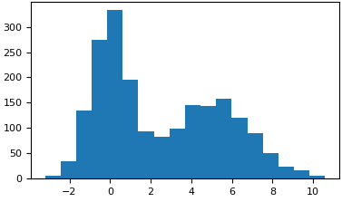
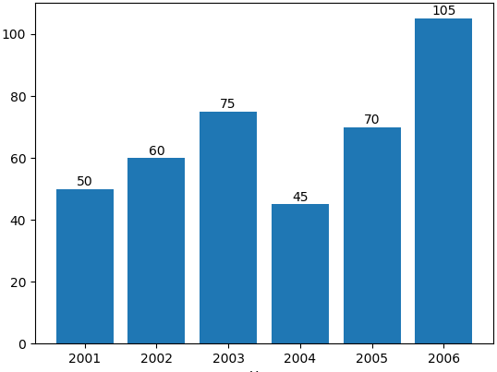
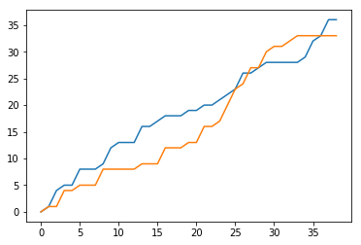
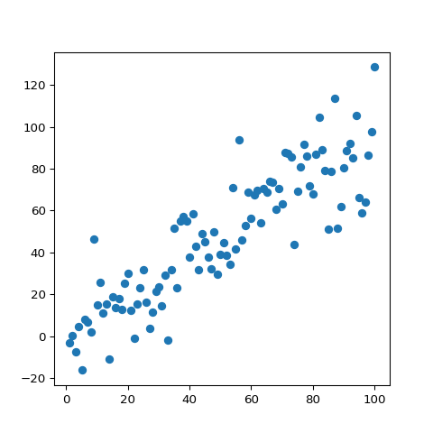
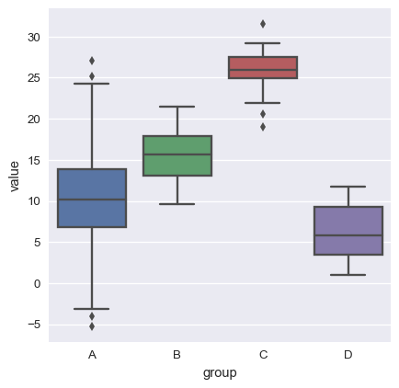
VISUALIZACIÓN DE DATOS
Los histogramas nos sirven para ver la distribución de los datos continuos. Y nos indica la frecuencia de ocurrencia de los datos continuos.
Las gráficas de barras nos sirven para ver distribución de datos categóricos y también para evaluar otras medidas además de frecuencia.
Las gráficas de líneas nos sirven para visualizar datos en una serie, generalmente serie de tiempo en orden cronológico. Es útil para evaluar tendencias en intervalos de tiempo.
Las gráficas de dispersión nos sirven para analizar la relación entre variables. Puede sugerir varios tipos de correlaciones y relaciones lineales o no lineales.
Los boxplot nos sirven para visualizar la distribución de los datos en cuartiles (“quartile”), identificando la mediana y valores atípicos (“outliers”).

Slide 45
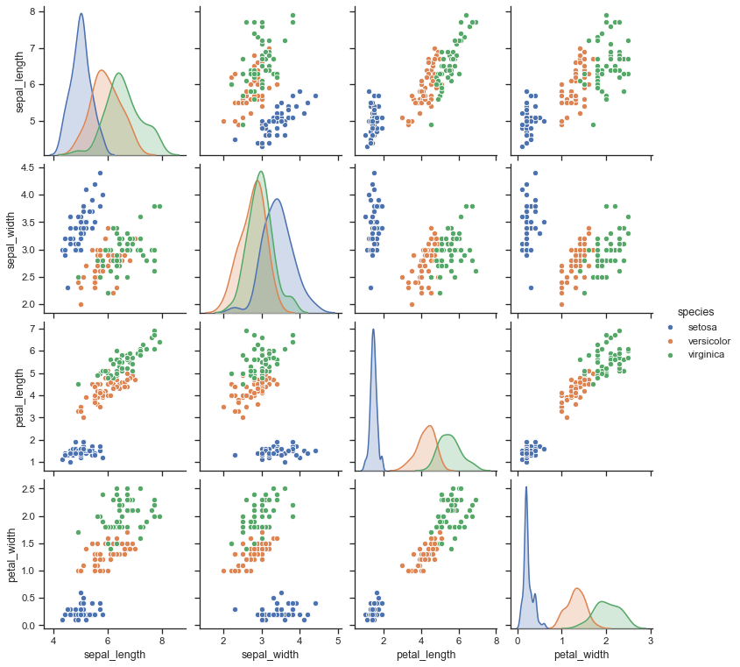
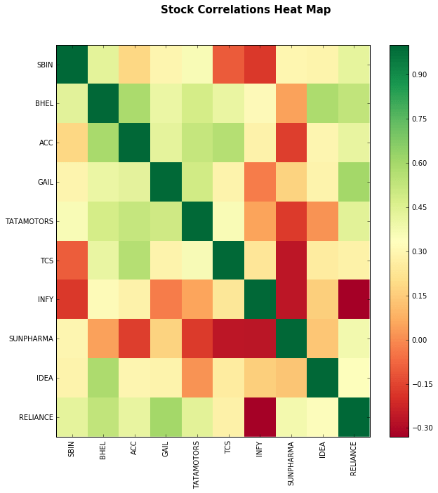
RELACIONES ENTRE VARIABLES
Las matrices de correlación nos permiten visualizar las correlaciones entre todas las variables numéricas de una tabla en un solo gráfico, y se suele usar el formato del mapa de calor para facilitar el análisis.
Las matrices de dispersión nos permiten consolidar en un mismo gráfico la comparación de variables numéricas de un dataset con gráficas de dispersión múltiples.

Slide 46
Machine Learning
ESCUELA FULLSTACK

Slide 47

REGRESIÓN LINEAL
Modelo lineal para explicar la relación entre una variable dependiente y una o más independientes.

Slide 48
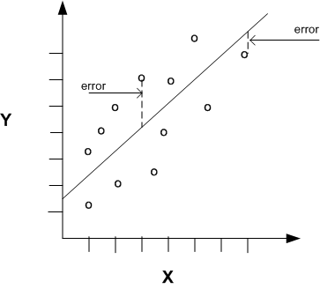
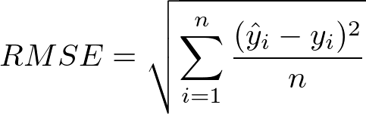
REGRESIÓN LINEAL
Para evaluar el modelo además de evaluar los coeficientes, el p-value y R2, debemos también evaluar el fit en el dataset test y podemos usar la medida de RMSE.

Slide 49
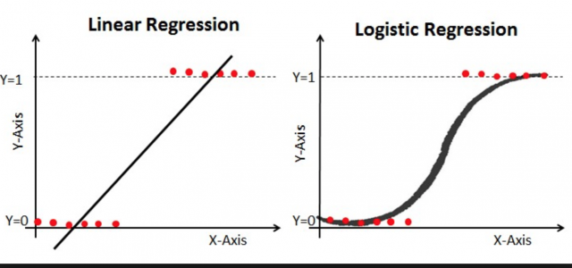

REGRESIÓN LOGÍSTICA
Modelo que usa la función logística para evaluar una variable dependiente binaria.
Fuente: medium.com

Slide 50
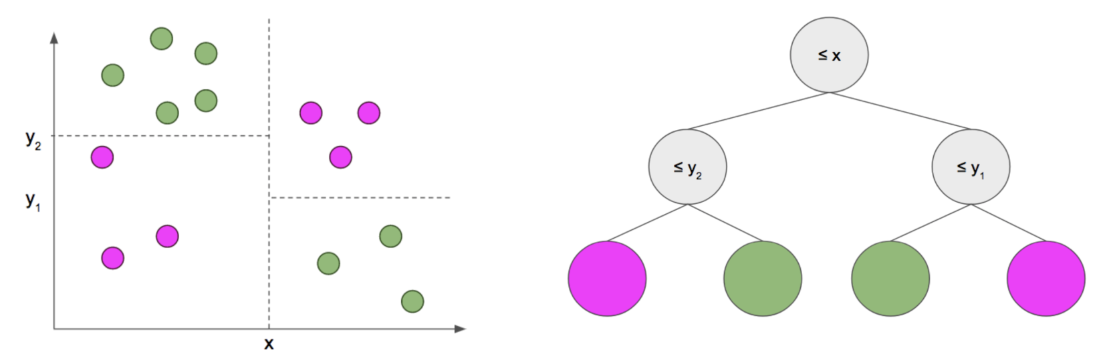
ÁRBOL DE DECISIÓN
Modelo con estructura de árbol similar al diagrama de flujo donde un nodo representa una variable o atributo, la rama representa una decisión y cada nodo hoja representa el resultado.
Fuente: bookdown.org

Slide 51
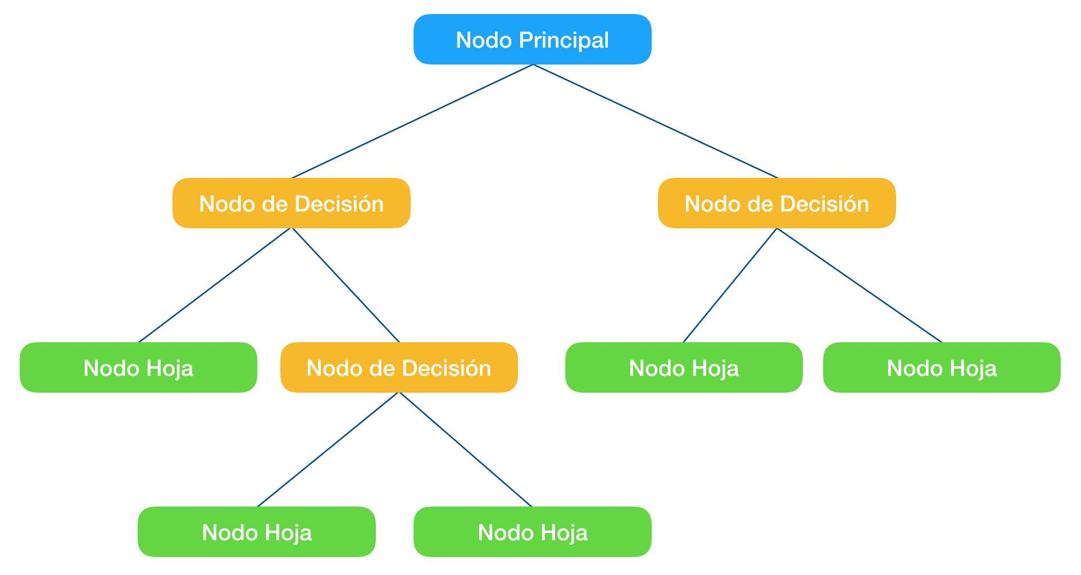
ÁRBOL DE DECISIÓN
Modelo que usa la función logística para evaluar una variable dependiente binaria.

